Slide 1
Production and Deployment
Deploying to an Environment

Slide 2
Agenda
Challenges and considerations
Infrastructure and environment setup for deployment
Choosing the right deployment infrastructure
Preparing the deployment environment (virtual machines, containers, serverless)

Slide 3
Challenges and considerations for deploying and maintaining ML models in production
Infrastructure and Environment Setup
Should be optimized for performance, security and scalability
Model Versioning and Management
Version control to manage different versions of the model, compare performance, and rollback if necessary
Continuous Integration and Deployment
This reduces the time to market and the possibility of human error
Model Monitoring and Logging
Identify any potential issues or errors and find areas for improvement
Model Testing and Evaluation
Before deploying an ML model in production, it is important to test and evaluate the model. This involves evaluating the performance of the model on different datasets and identifying any issues or errors that need to be addressed.
Security and Compliance
Management of access controls, data encryption, and data anonymization
Scaling and Cost Optimization

Slide 4
Choosing the right deployment infrastructure
On-Premise Deployment
Deploying the ML model on infrastructure that is owned and managed by the organization
Provides greater control over the hardware and software environment and can be more cost-effective for long-term deployment, but requires significant upfront investment in hardware and software infrastructure, and may be less scalable than cloud-based deployment
Cloud Deployment
Cloud deployment involves deploying the ML model on infrastructure that is owned and managed by a cloud provider such as AWS, Azure, or GCP.
Offers greater scalability, flexibility, and pay-per-use pricing models and to specialized hardware (GPUs and TPUs). It can be more expensive in the long term, and may require additional security and compliance considerations
Hybrid Deployment
Involves a combination of on-premise and cloud deployment.
Gives the control and security of on-premise deployment with the scalability and flexibility of cloud deployment. However, it can be more complex to manage and requires additional integration and management considerations

Slide 5
Preparing the deployment environment
Infrastructure
Appropriate hardware and software infrastructure to support the ML model
Specialized hardware, as well as software libraries and frameworks necessary for the model to run.
Data and Model Management
Model should be available to all resources that need to use it (FTP, AWS S3,...)
Security
Security measures to protect the model and data
Access controls, network security, and encryption
Monitoring and Logging
Setting up performance metrics and alerts, as well as logging errors and other events.
Testing and Validation
Testing the model with a range of inputs and data scenarios, as well as stress testing the infrastructure.

Slide 6
Production and Deployment
Deploying a Model

Slide 7
Optimizing the model for deployment by reducing its size and complexity
Model pruning
Removes unimportant weights from the model, resulting in a smaller and more efficient model
Quantization
Reduces the precision of the model's weights and activations. This can result in a smaller model that can be run more efficiently on hardware with lower precision requirements
Compression
Reduce the size of the model by encoding it in a more compact form
Transfer learning
Technique that uses a pre-trained model as a starting point for a new model

Slide 8
Defining the API methods, request and response formats, and authentication and security mechanisms
API methods
Actions that can be performed on the model through the API (e.g. predict, train, evaluate)
Request and response formats
Structure and content of the data that is passed to and returned by the API
This includes specifying the data type and format, as well as any required or optional fields
Authentication and security mechanisms
Authentication and security mechanisms are critical for protecting the API and the data it handles.
This includes methods such as OAuth, API keys, and SSL/TLS encryption. It is important to carefully consider the authentication and security requirements of the API, as well as any regulatory or compliance requirements that may apply.

Slide 9
Invoking the ML model
Data preparation
Ensure that it is in the correct format and meets any requirements specified by the API documentation.
This may include preprocessing, scaling, or encoding the data.
API endpoint
The API endpoint specifies the location where the API can be accessed. It may include a URL, IP address, or domain name
Error handling
It is important to handle errors that may occur during the API invocation, such as incorrect data format or missing parameters. The API should provide clear error messages and status codes to facilitate troubleshooting and debugging
Rate limiting
API of the ML model should clearly state the acceptable rate of incoming requests that it can safely processes

Slide 10
Production and Deployment
Maintaining Models

Slide 11
Production and Deployment
Maintaining Models

Slide 12
Monitoring Models and Detecting Model Drift
Data monitoring
Monitoring the input data to the model can help detect changes in the data distribution that may affect the model's performance
Model performance monitoring
Monitoring the performance of the model can help detect changes in the model's accuracy or other metrics
Automated alerting
Setting up automated alerting systems can help detect model drift in real-time and trigger actions such as model retraining or versioning
Model retraining
When model drift is detected, it may be necessary to retrain the model on new data to improve its performance

Slide 13
Model versioning with AWS
Model versioning is process of assigning unique ID to each new model that we want to deploy.
Creating model ID can be something simple like numeric auto-increment or custom name that codifies time of creation, features used etc
Versioning helps with:
Reproducibility
Debugging
Transparency
Collaboration
Maintenance
AWS Sagemaker offers Model Registry
Automatically saves and versions ML models
Reduces amount of manual work for ML Engineers
Available in AWS Sagemaker Studio

Slide 14
Production and Deployment
DEMO

Slide 15
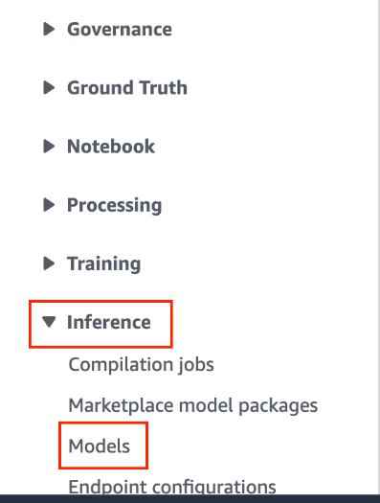
Production and Deployment
In AWS Sagemaker console, under Inference select Models

Slide 16
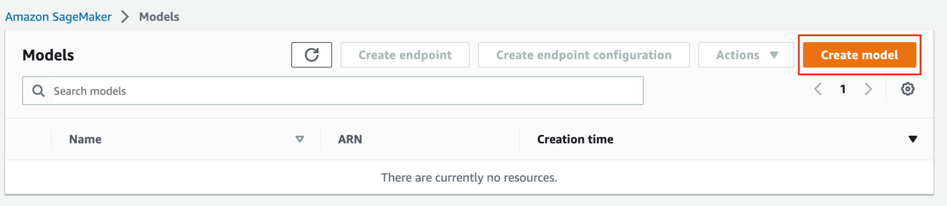
Production and Deployment
Click Create model button

Slide 17
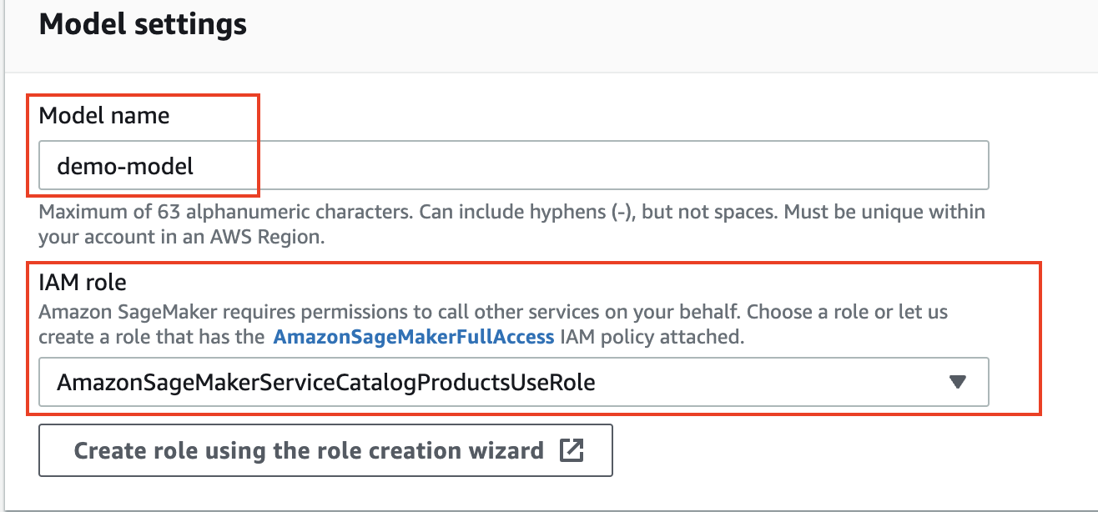
Production and Deployment
Make sure that model name and IAM role are selected properly

Slide 18
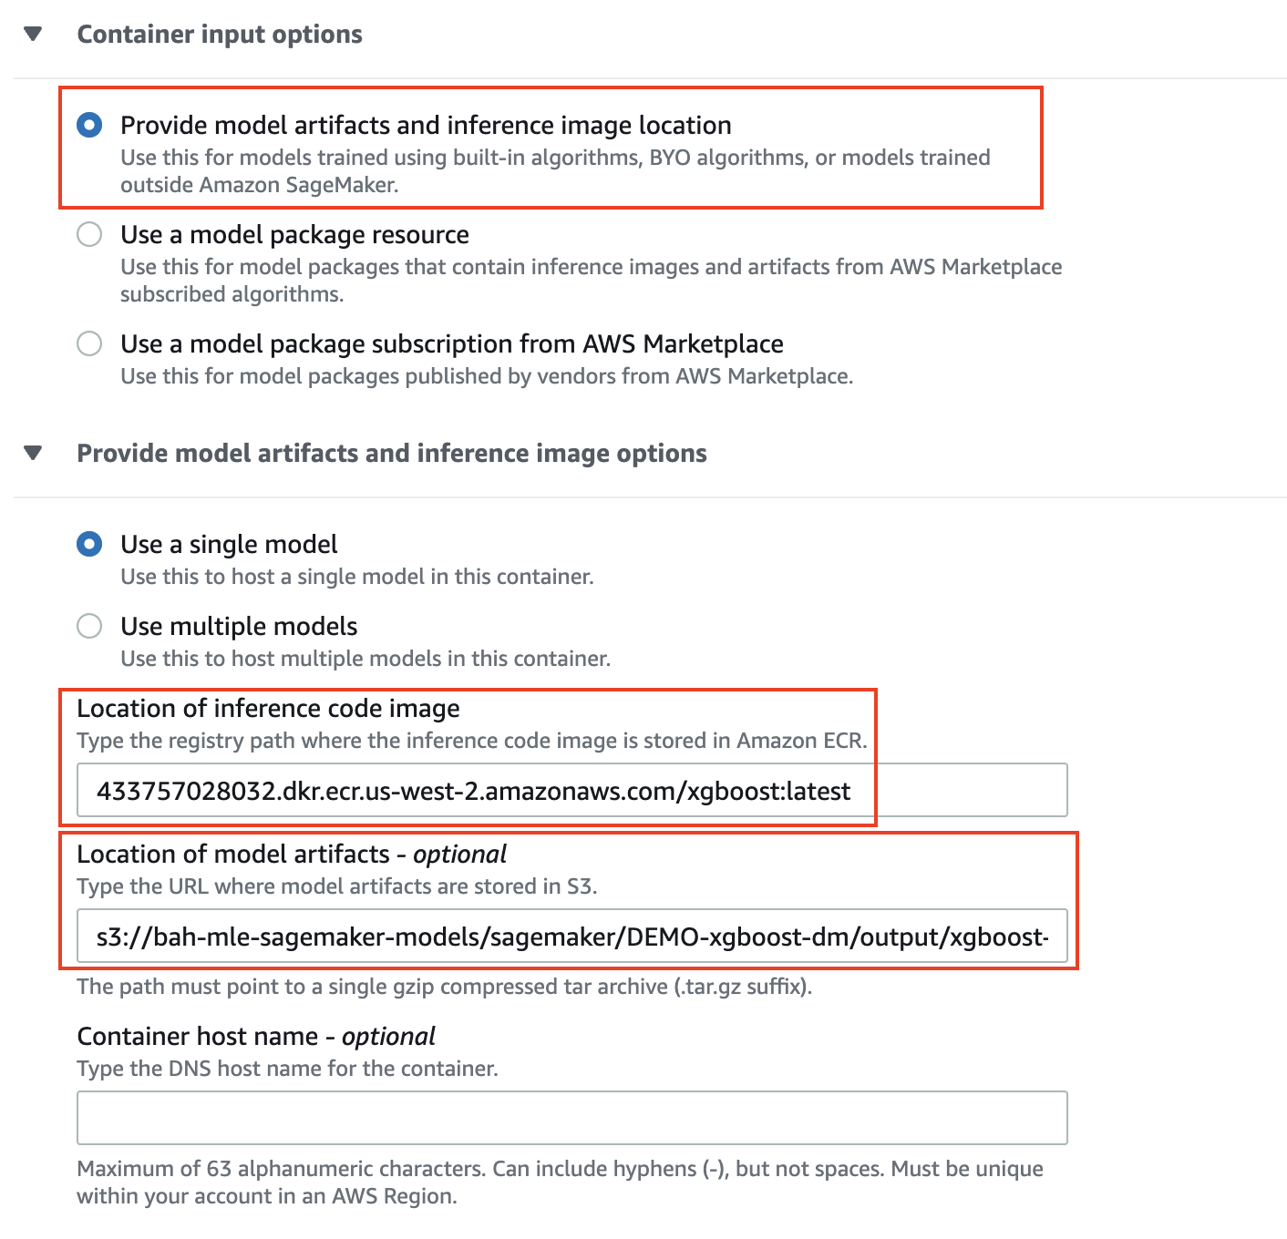
Production and Deployment
Under Container input options, make sure to select Provide model artifacts and inference image location
Afterwards, select correct Location of inference code image and Location of model artifacts
Click Create model button

Slide 19
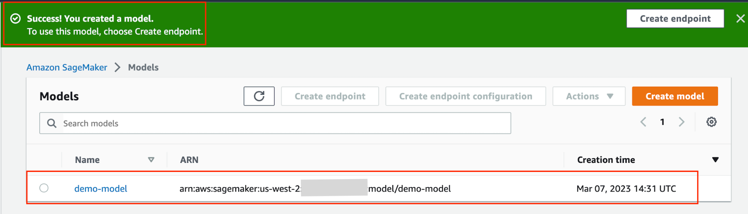
Production and Deployment
After model is created AWS UI will display success message and add model to the list of existing models

Slide 20
Production and Deployment
After model is created AWS UI will display success message and add model to the list of existing models

Slide 21
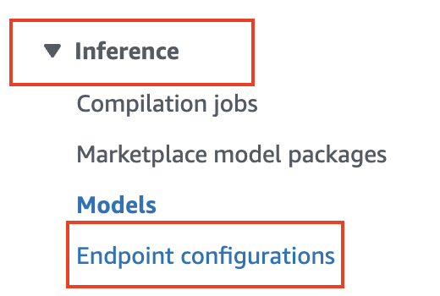
Production and Deployment
Now we are going to make an Endpoint configuration resource
Under Inference select Endpoint configurations

Slide 22
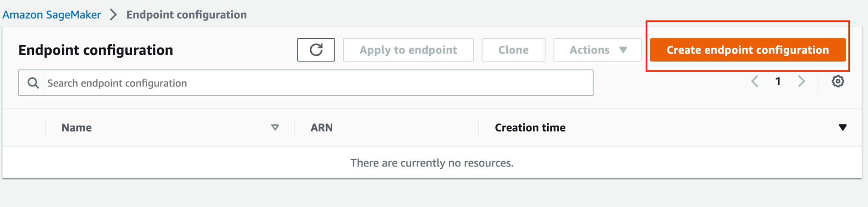
Production and Deployment
On Endpoint configuration button, click Create endpoint configuration

Slide 23
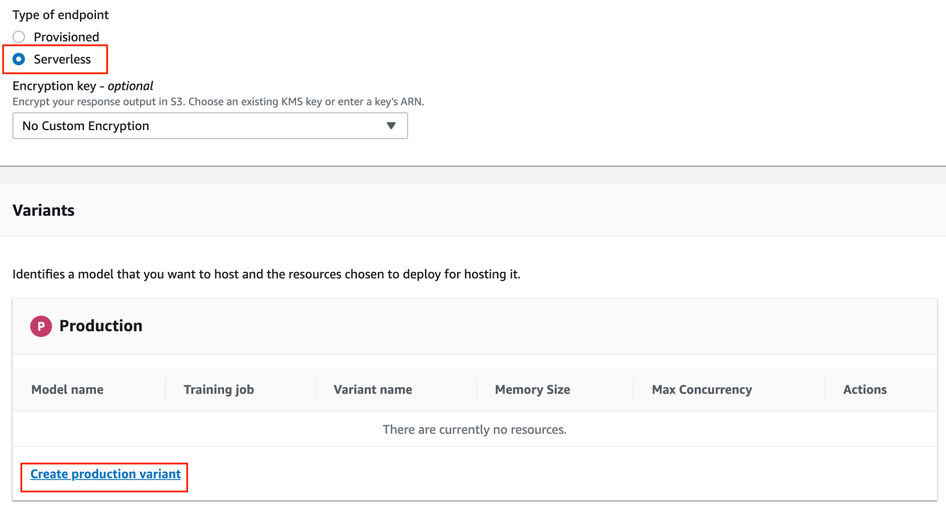
Production and Deployment
After naming an endpoint, for Type of endpoint select Serverless
This means that we will not manage (or be billed for) EC2 instances for hosting the model
Instead, we will be billed directly for amount of resources configured
Click Create production variant

Slide 24
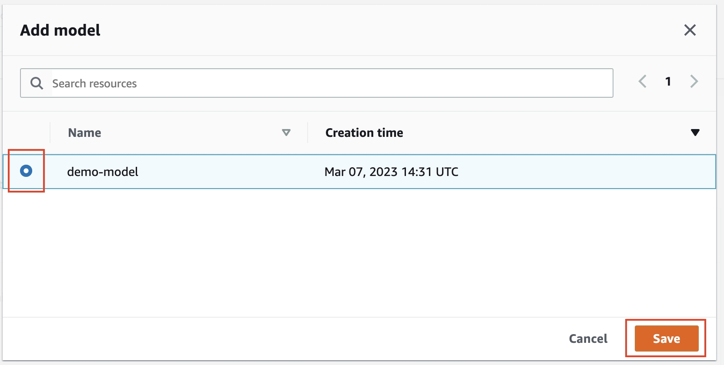
Production and Deployment
On the new popup, select recently created model and click Save

Slide 25
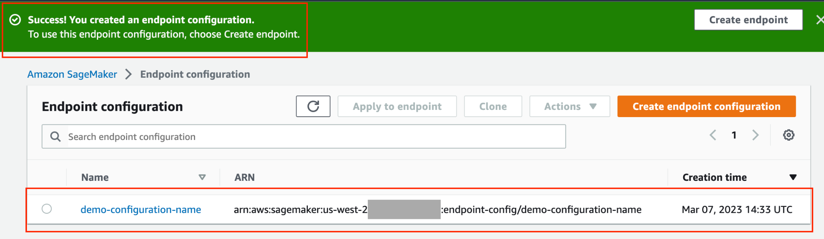
Production and Deployment
Success message is displayed and new configuration is listed in the UI

Slide 26
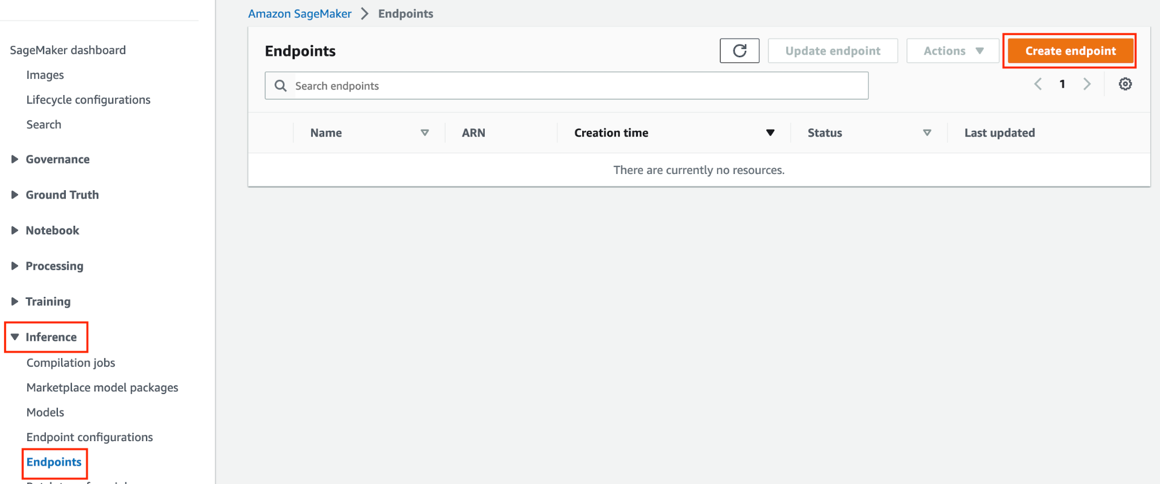
Production and Deployment
Finally, we are going to created Endpoint resource
Under Inference, click Endpoint
To start creating endpoint resource, click Create endpoint button

Slide 27
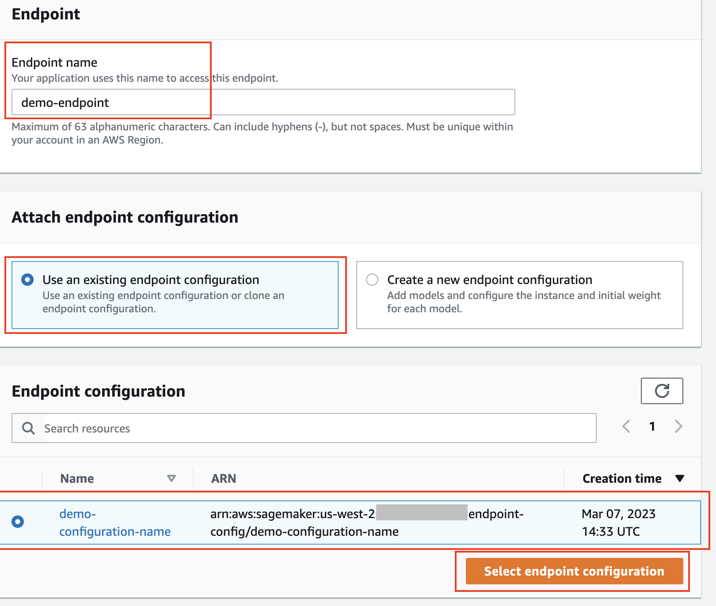
Production and Deployment
When Attaching endpoint configuration, click Use an existing endpoint configuration
Select recently created configuration
Click Select endpoint configuration button

Slide 28
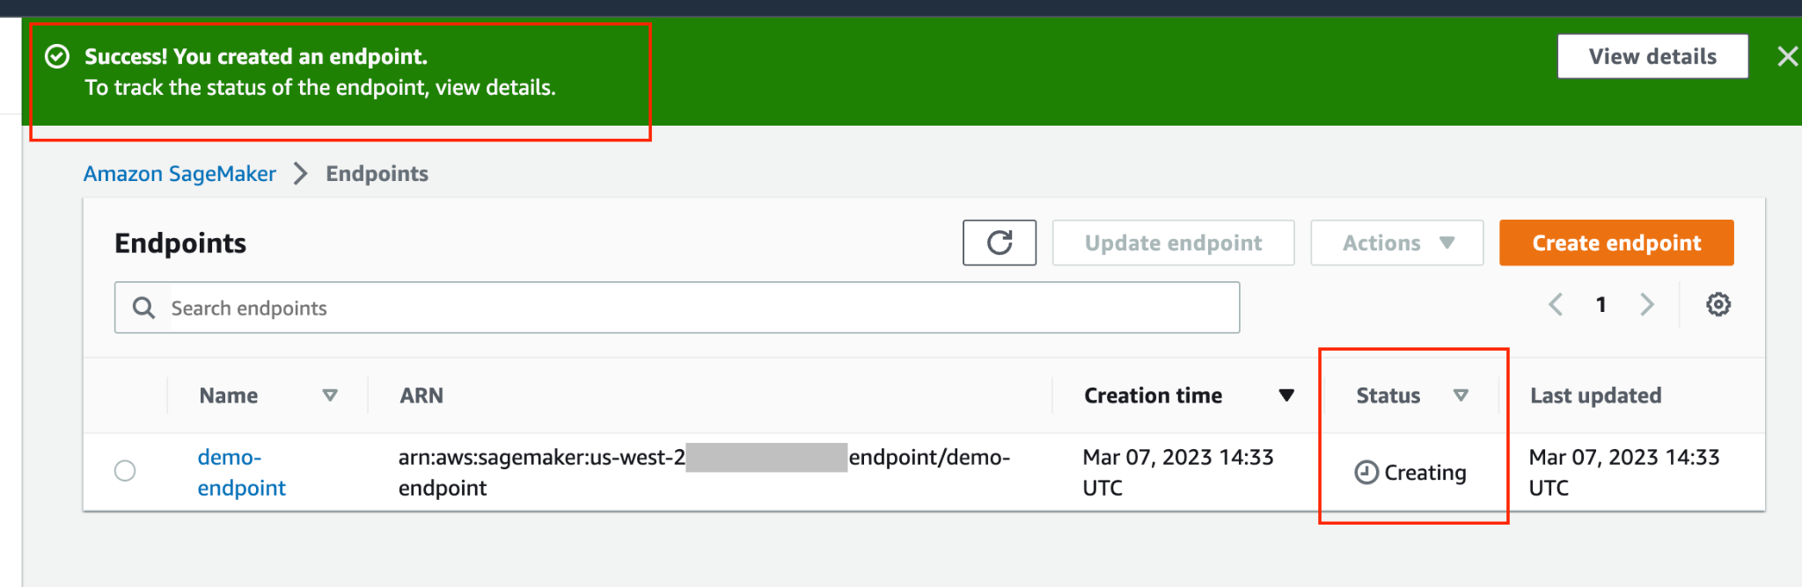
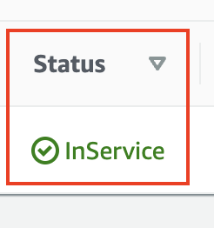
Production and Deployment
Success message is shown and new model endpoint is shown in Creating state
After several minutes, the state should update to InService

Slide 29
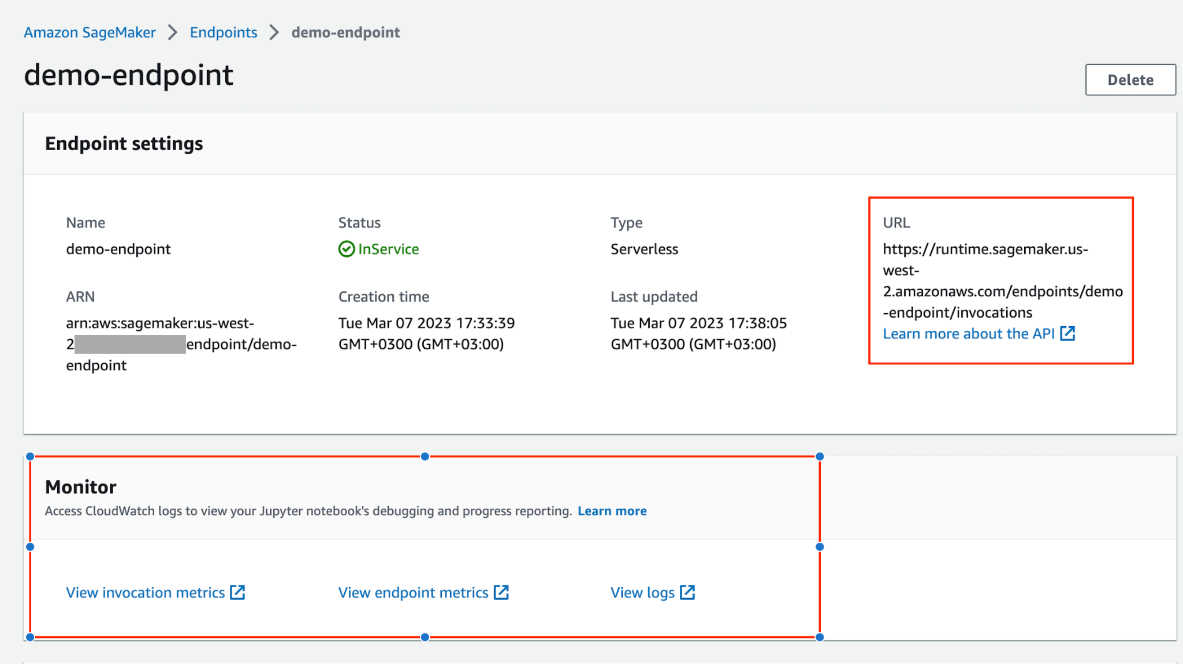
Production and Deployment
Finally, we can click on a endpoint to see it’s details

